Slide 1


Konstantin Boudnik
VP Open Source Development, WANdisco Member of the Apache Software Foundation
Accelerating the Hadoop data stack with
Apache Ignite™, Spark and Bigtop
Nikita Ivanov
CTO, GridGain Systems
Member of the PMC for Apache Ignite
http://bigtop.apache.org
http://ignite.apache.org

Slide 2
Apache Bigtop primer
A project, environment, and a philosophy to:
Define and create software stacks (think Debian)
Deploy and validate actual software in the real world
Configuration management
Guarantees of consistency and compatibility
Empirical vs. Rational
don't rely on someone's hearsay
don't assume an environment: control it

Slide 3
Apache Bigdata stack
Bigtop is the cutting edge of Apache Bigdata stack
Delivers:
A ready data processing stack
Dev. env. for anyone to create their own
Framework for easy integration/deployment/validation
“It works on my laptop” isn't cool anymore
0.x release series was focused on Hadoop ecosystem

Slide 4
Let's get serious about IMC
Bigtop boards more & more IMC(-like) components
Provides transitional tech for legacy MR-based users
HDFS acceleration
MR acceleration
Uses RAM as inter-component data media
Crossing component boundaries w/o leaving RAM
Advanced clustering and service models

Slide 5
Connecting the stack
Bigtop Data Fabric Core:
Works with HDFS/RDBMS/MR/Hive/Hbase/Spark/Storm/SQL
Cluster memory is a natural media to exchange data
A usecase:
Kafka --> Data Fabric --> HBase --> Data Fabric --> SQL querying --> Spark --> A service Singlethon --> Data Fabric --> RDBMS/FS

Slide 6
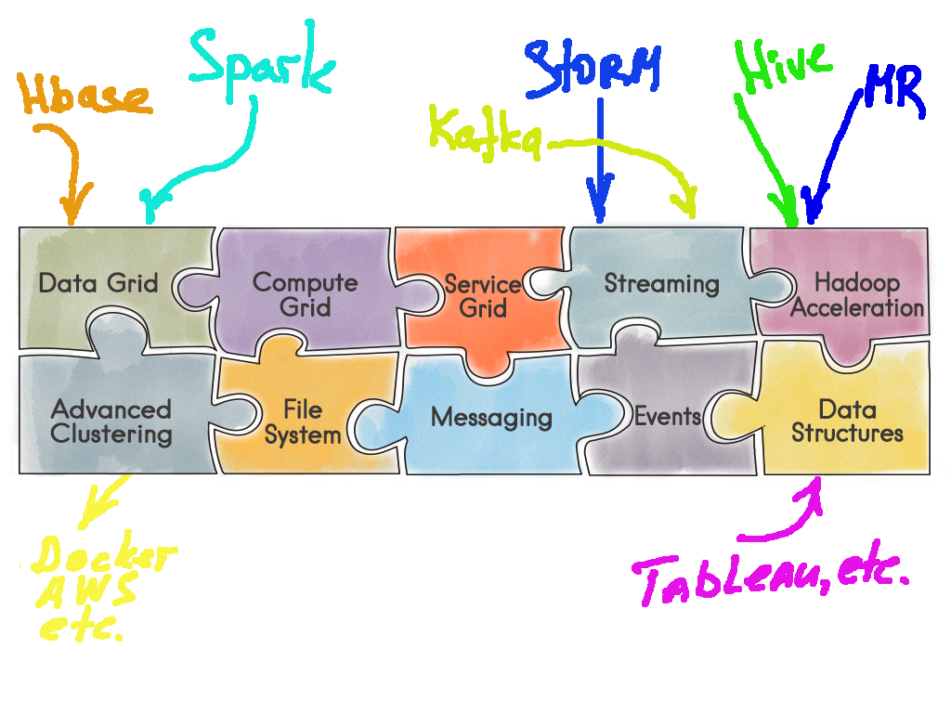
Connecting the ...

Slide 7
Live Demo
Deploy Apache Ignite (incubating)
Run MR Pi on YARN
Run same MR Pi on Apache Ignite:
Only client config needs to be changed
Run MR Teragen
Run MR Terasort on YARN vs Ignite IGFS
Run Spark queries w/ & w/o Ignite caching

Slide 8
Results review
Workload | Without Ignite | With Ignite
MapReduce: CPU-bound (Pi)
MapReduce IO-bound: (TeraGen/Sort)
Spark SQL

Slide 9
In-Memory Data Fabric Strategic Approach to IMC
Supports Applications of various types and languages
Open Source – Apache 2.0
Simple Java APIs
1 JAR Dependency
High Performance & Scale
Automatic Fault Tolerance
Management/Monitoring
Runs on Commodity Hardware
Supports existing & new data sources
No need to rip & replace

Slide 10
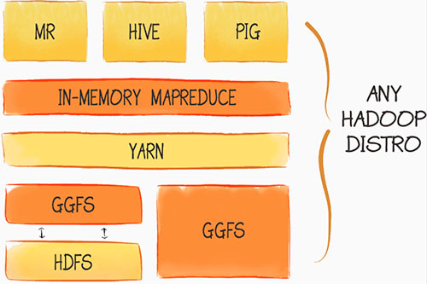
In-Memory Hadoop Accelerator
Plug and Play installation
10x to 100x Acceleration
In-Memory Native MapReduce
In-Process Data Colocation
IgniteFS In-Memory File System
Read-Through from HDFS
Write-Through to HDFS
Sync and Async Persistence

Slide 11
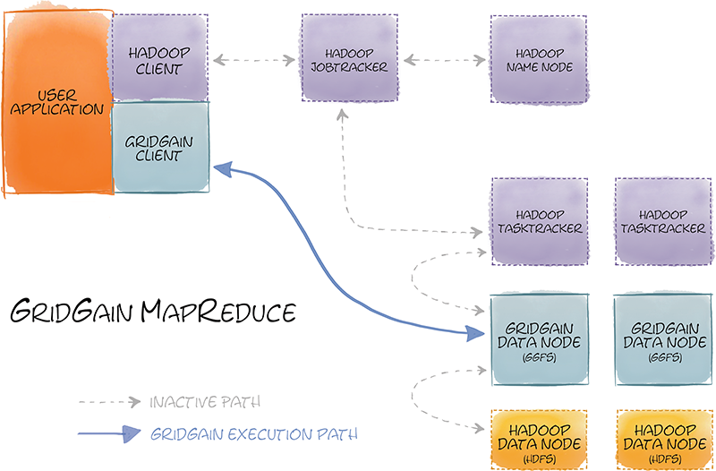
In-Memory Hadoop Accelerator
Zero Code Change
In-Memory Native Performance
Use existing MR code
Use existing Pig/Hive queries
No Name Node
Eager Push Scheduling

Slide 12
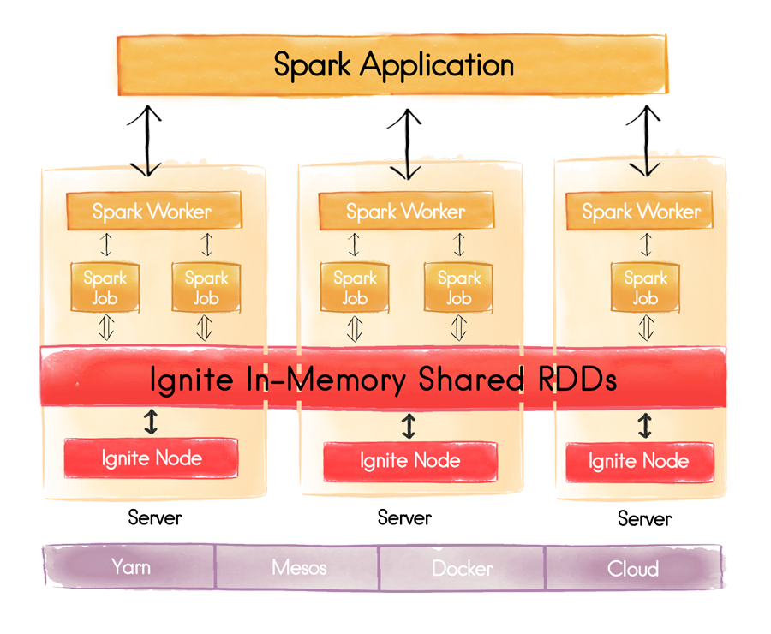
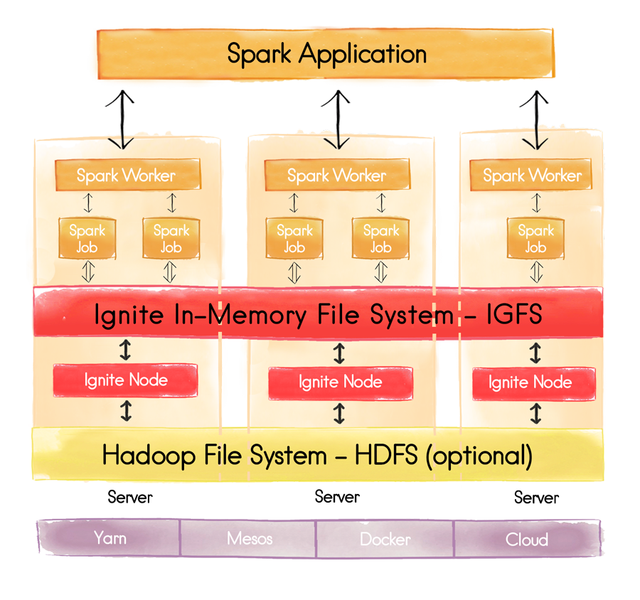
Spark Integration – IGFS & Shared RDD

Slide 13

ANY Questions?
Thank you for joining us. Follow the conversation.
Konstantin Boudnik
VP Open Source Development, WANdisco Member of the Apache Software Foundation
Nikita Ivanov
CTO, GridGain Systems
Member of the PMC for Apache Ignite
http://bigtop.apache.org
http://ignite.apache.org
#apachebigtop
#apacheignite

